Slide 1



Title
AirAware - Smart Air Quality prediction system
NAME: SAHIL CHOUDHARY
TEAM NO. 2
PROJECT NAME: AIRAWARE - SMART AIR QUALITY PREDICTION SYSTEM

Slide 2



Introduction
Air Aware is a smart, AI-powered web-based system designed to monitor, analyse, and forecast air quality in real time. The platform integrates Machine Learning (ML), modern web technologies, APIs, and databases to deliver accurate Air Quality Index (AQI) predictions to users.
The system processes pollutant data such as PM2.5, PM10, NO2, SO2, CO, and Ozone, collected from datasets (Kaggle, Hugging Face, OpenAQ) and real-time sensors. After processing the input using ML models, Air Aware provides:
·Real-time AQI
·Future AQI forecast
·Weather conditions (Sunny, Rainy, Cloudy, etc.)
·Health implications (Safe / Unsafe to inhale)
The goal is to achieve 95–98% model accuracy and provide interactive dashboards for clean and meaningful insights to the user.

Slide 3
Project Objectives
  Monitor pollution levels efficiently
  Provide real-time & historical air quality insights
  Offer a clean, responsive dashboard
  Support data export & future ML model integration
  Build a scalable backend API using Flask

Slide 4
Frontend Overview and Features
Features
  Color-coded AQI indicators
  Line charts for pollutant trends
  Table for live pollutant readings
  Auto-refresh mechanism for updated data
  Error handling for missing API data
Overview
  Developed using HTML, CSS, JavaScript
  Fully responsive layout
  Real-time AQI dashboard
  Charts to visualize pollutant trends
  Filters: city, date range, pollutant type
  Intuitive UI suitable for mobile and desktop
  Modular and reusable components

Slide 5
Backend Overview
  Backend developed in Python (Flask)
  Processes raw CSV dataset
  Cleans null values & converts datatypes
  Generates API endpoints (/data, /cities, /filter)
  Handles date-range filtering
  Optimized for fast responses
  Supports integration with future ML model

Slide 6
Dataset Used
Dataset
  Original File: Maharashtra.xlxs
  Cleaned File: cleaned_data.csv
  Rows: ~48,000+
  Columns:
  datetime
  PM2.5
  PM10
  NO₂
  SO₂
  CO
  O₃
  AQI Category
  Cleaning Steps:
  Null removal
  Type conversion
  Duplicate removal
  Outlier correction
Database
Using MySQL
Cleaned dataset stored for faster querying
Supports:
  city-wise filtering
  pollutant-wise filtering
  date-wise filtering
  Backend fetches data directly from cleaned database

Slide 7
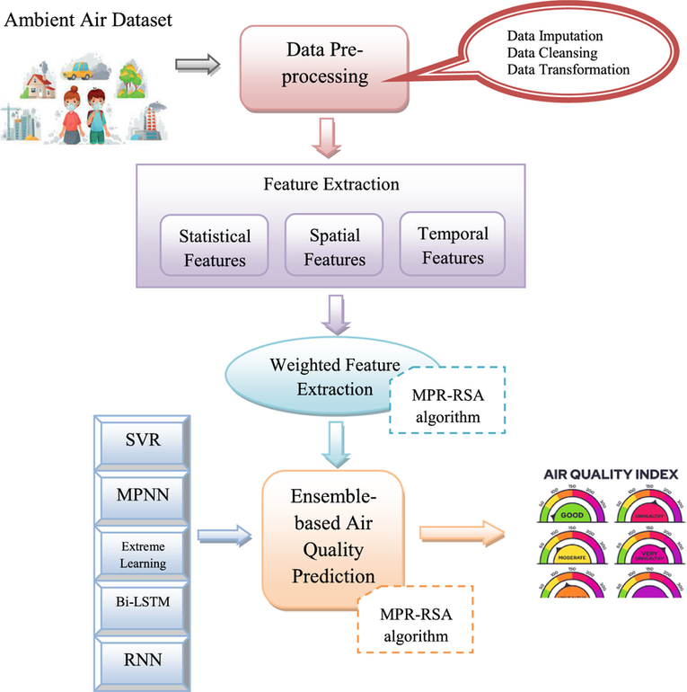
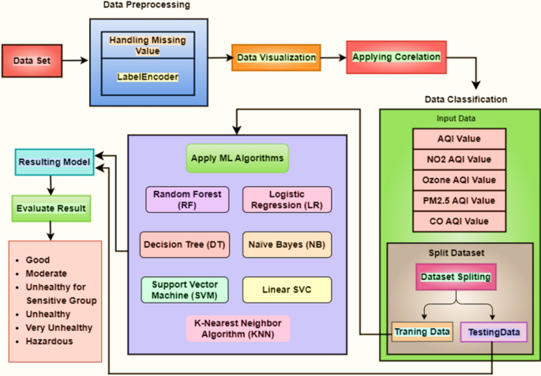
Architecture

Slide 8
Challenges Faced
  Large dataset size causing slow loads
  Cleaning inconsistent timestamps
  Maintaining data accuracy
  Creating responsive pollutant charts
  Backend performance optimization

Slide 9
Conclusion
AirAware provides an efficient and visually appealing solution for monitoring air pollution. It integrates data cleaning, processing, and real-time visualization into a full-stack system. The project lays the foundation for future enhancements such as machine learning–based anomaly detection, forecasting, and deep analytics for environmental studies.

Slide 10
Thank You

